Slide 1
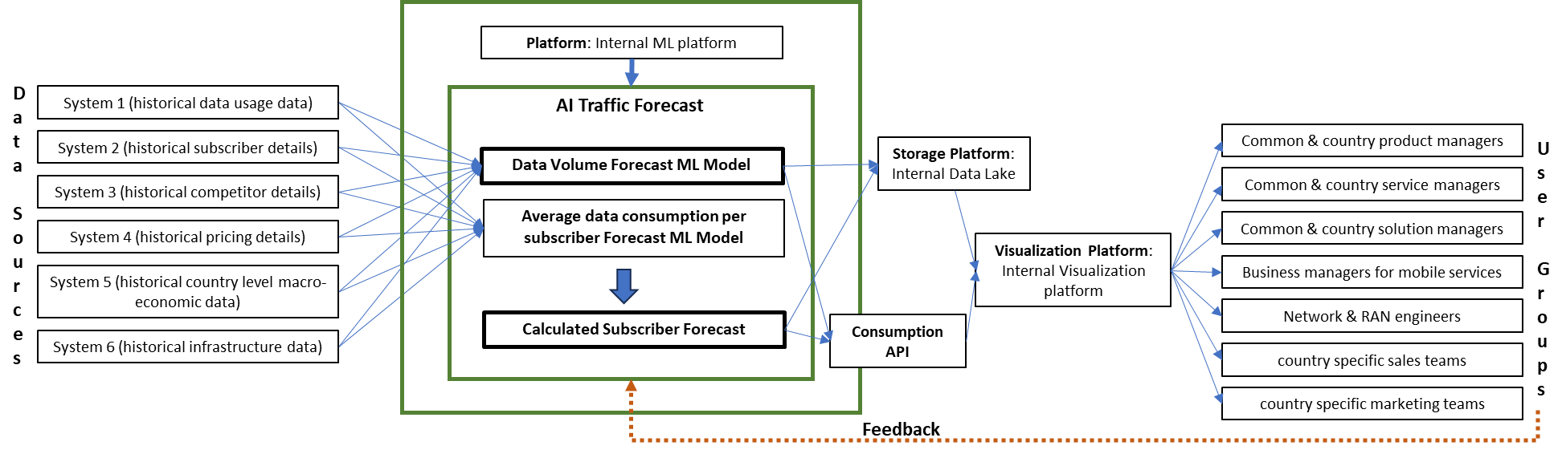

Slide 2
Platform: Internal ML platform
Data
Sources
System 1 (historical data usage data)
AI Traffic Forecast
System 2 (historical subscriber details)
Storage Platform: Internal Data Lake
Common & country product managers
User
Groups
Data Volume Forecast ML Model
System 3 (historical competitor details)
Common & country service managers
Average data consumption per subscriber Forecast ML Model
Common & country solution managers
System 4 (historical pricing details)
Visualization Platform: Internal Visualization platform
System 5 (historical country level macro-economic data)
Business managers for mobile services
Calculated Subscriber Forecast
Consumption API
Network & RAN engineers
System 6 (historical infrastructure data)
country specific sales teams
country specific marketing teams
Feedback

Slide 3
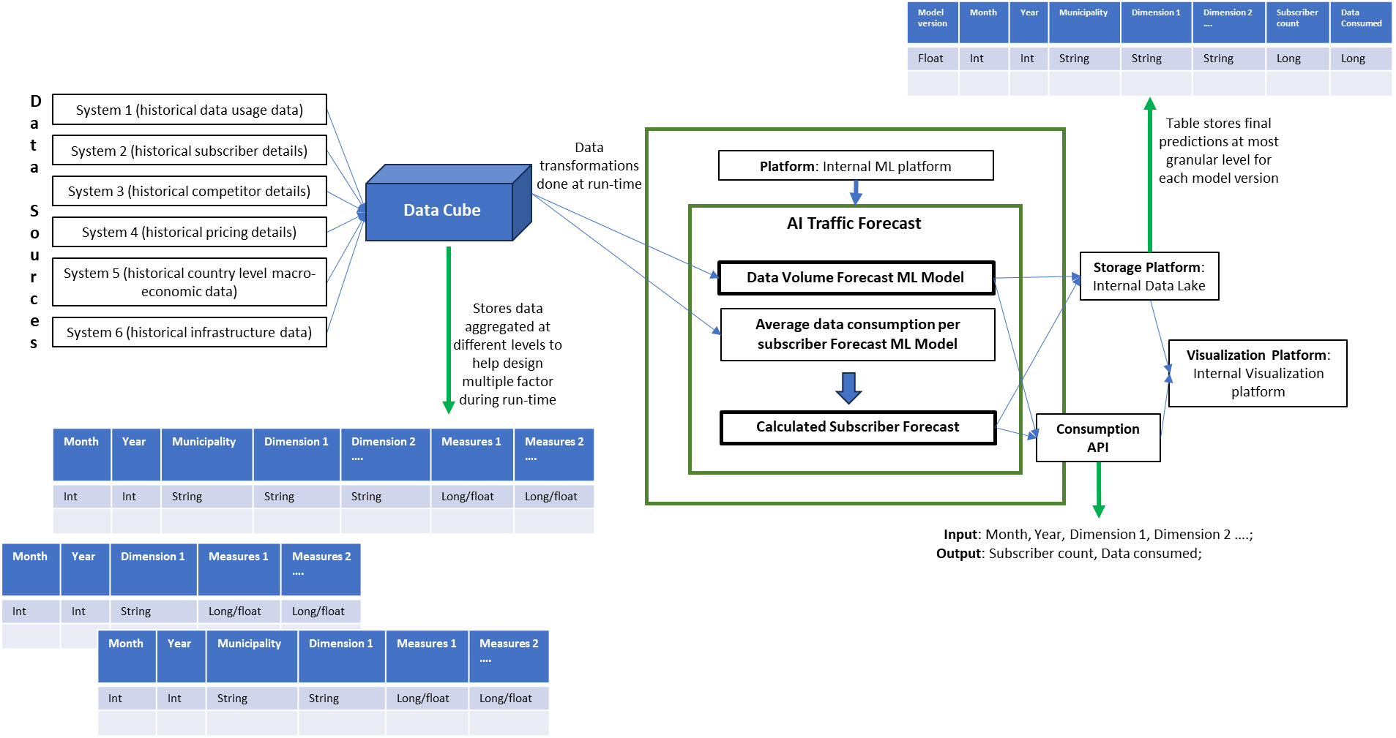

Slide 4
Model version | Month | Year | Municipality | Dimension 1 | Dimension 2 …. | Subscriber count | Data Consumed
Float | Int | Int | String | String | String | Long | Long
Data
Sources
System 1 (historical data usage data)
Table stores final predictions at most granular level for each model version
System 2 (historical subscriber details)
Data transformations done at run-time
Platform: Internal ML platform
System 3 (historical competitor details)
Data Cube
AI Traffic Forecast
System 4 (historical pricing details)
System 5 (historical country level macro-economic data)
Data Volume Forecast ML Model
Storage Platform: Internal Data Lake
Stores data aggregated at different levels to help design multiple factor during run-time
Average data consumption per subscriber Forecast ML Model
System 6 (historical infrastructure data)
Visualization Platform: Internal Visualization platform
Calculated Subscriber Forecast
Consumption API
Month | Year | Municipality | Dimension 1 | Dimension 2 …. | Measures 1 | Measures 2 ….
Int | Int | String | String | String | Long/float | Long/float
Input: Month, Year, Dimension 1, Dimension 2 ….;
Month | Year | Dimension 1 | Measures 1 | Measures 2 ….
Int | Int | String | Long/float | Long/float
Output: Subscriber count, Data consumed;
Month | Year | Municipality | Dimension 1 | Measures 1 | Measures 2 ….
Int | Int | String | String | Long/float | Long/float

